Slide 1
Averaging and the dynamics of stochastic switching in bistability
Sara Steele, Dan Tranchina, and John Rinzel

Slide 2
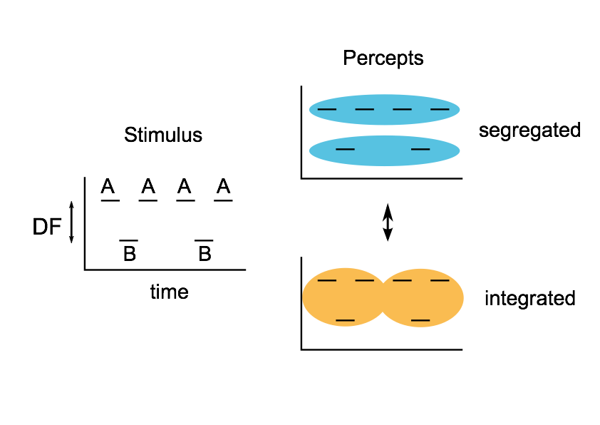
Buildup with ABA
For long presentations, stimulus elicits perceptual bistability
No (first order) correlations between subsequent percept durations
First percept is always integration, with a slightly longer mean duration
Otherwise, distributions of percept durations are stationary

Slide 3

DF = 2 st
DF = 11 st
DF = 5 st
stimuli: van Noorden, 1975

Slide 4
DF = 2 st
DF = 11 st
DF = 5 st
stimuli: van Noorden, 1975

Slide 5

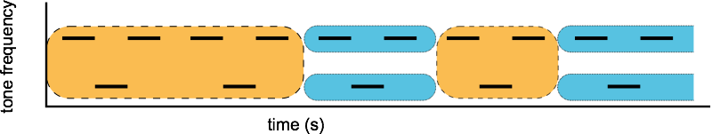
DF = 2 st
DF = 11 st
DF = 5 st
stimuli: van Noorden, 1975

Slide 6
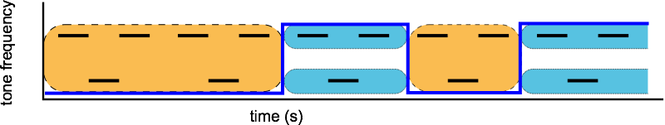
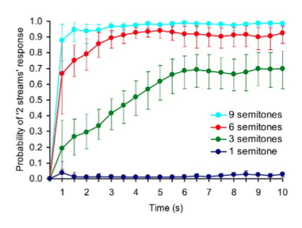
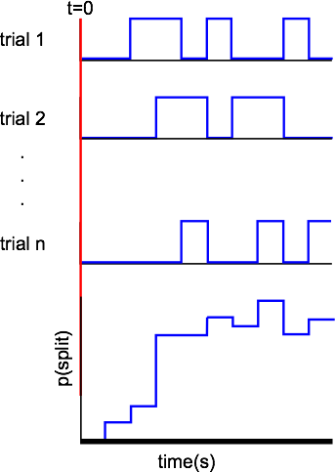
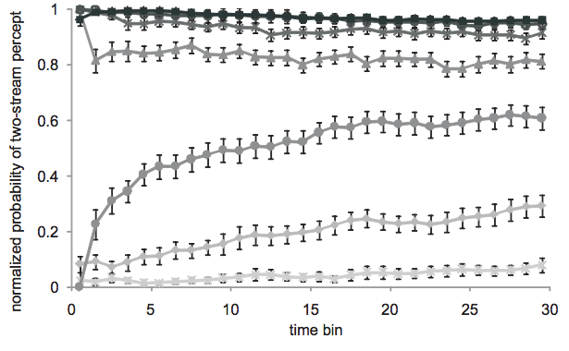
Psychophysical buildup curves
Micheyl, et. al. (2005)
Dieke, et. al. (2012)

Slide 7

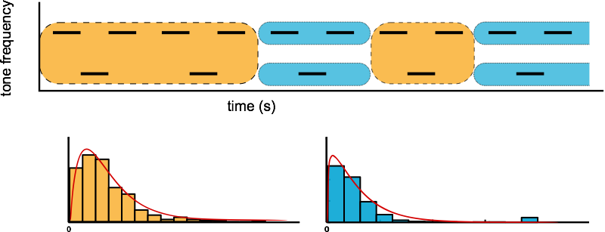


Durations could be drawn from independent gamma densities
z(t)
fT0
fT1
r(T0, T1) = 0

Slide 8
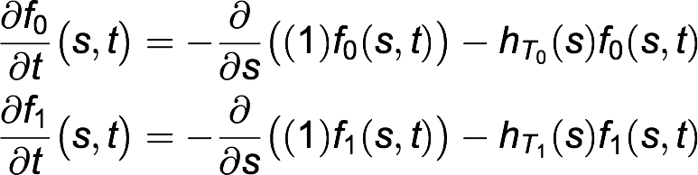
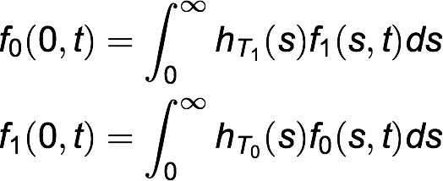
Alternating renewal process
Two independent stationary probability densities over state duration
Starting state is known
Density for the first duration of the first state might be different
BCs:
ICs:

Slide 9
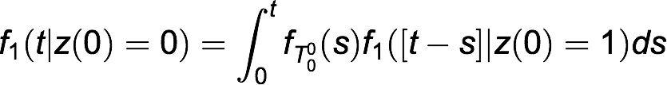

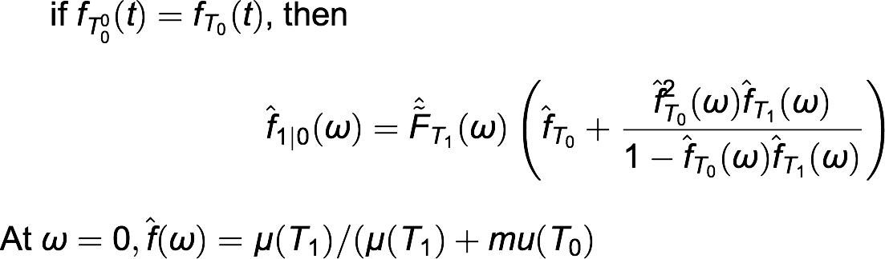
Solution

Slide 10
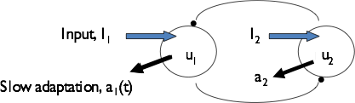
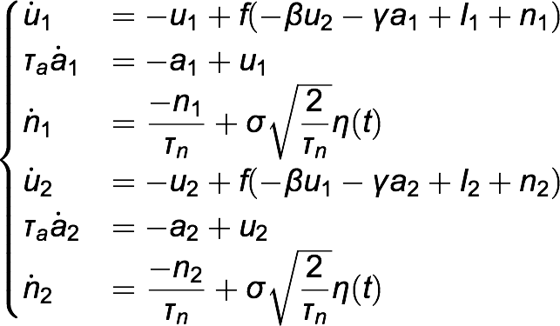


Competition firing rate models
Shpiro et. al. (2009)

Slide 11
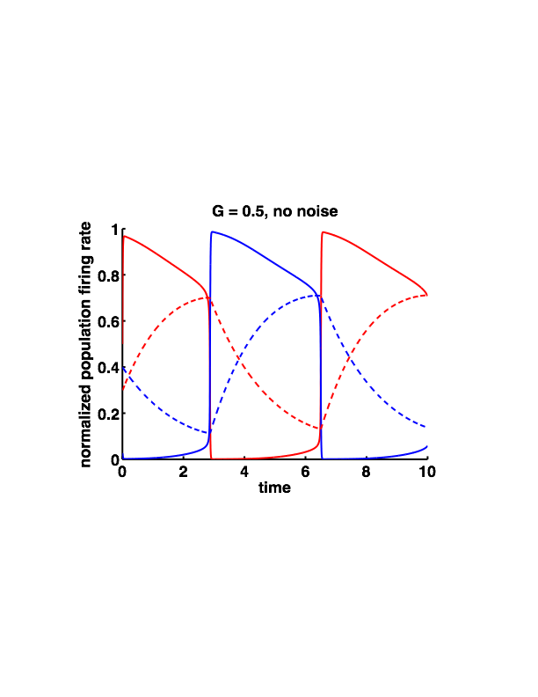
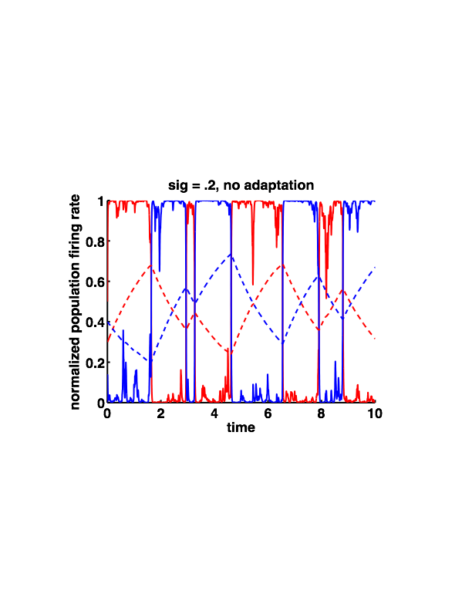
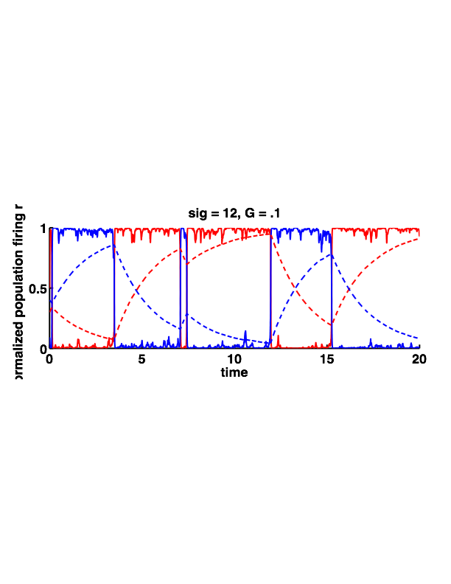
Typical output
Iboth = 0.6

Slide 12
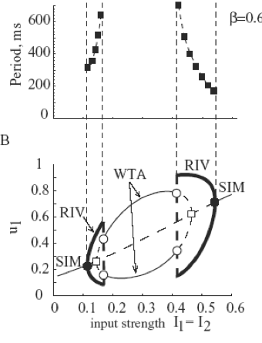
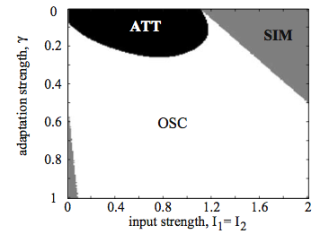
Bifurcations

Slide 13
Generating simulated buildup curves
Shpiro et. al. (2009)
with ICs u1(0) = 0.5, u2(0) = 0;
500 simulated 10 s trials

Slide 14
Psychophysical buildup curves
Micheyl, et. al. (2005)
Dieke, et. al. (2012)

Slide 15
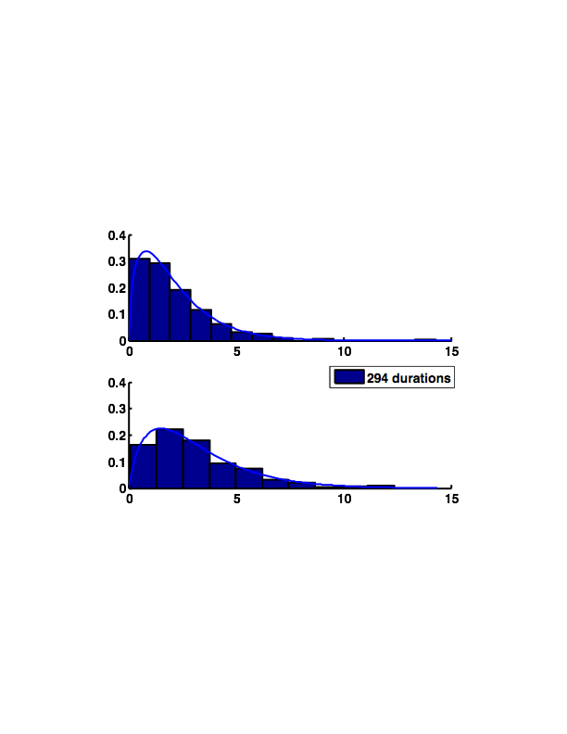
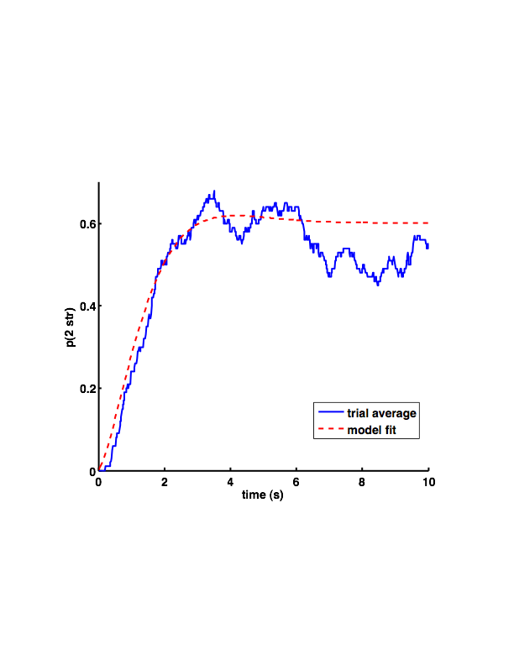
Short trials- like Micheyl et al
k=1.60
θ=1.34
k=1.86
θ=1.74

Slide 16
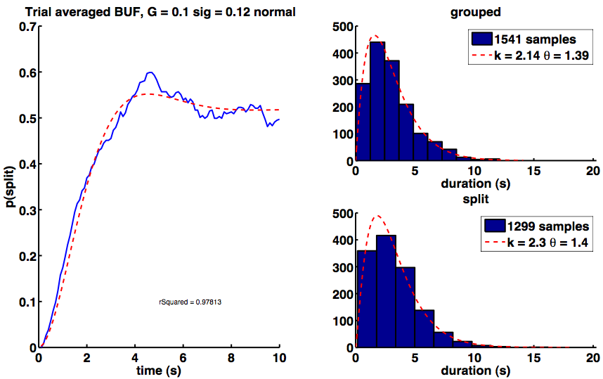
Durations constrain buildup function
corrcoef(Durs(1:end-1), Durs(2:end)) = 0.0339

Slide 17
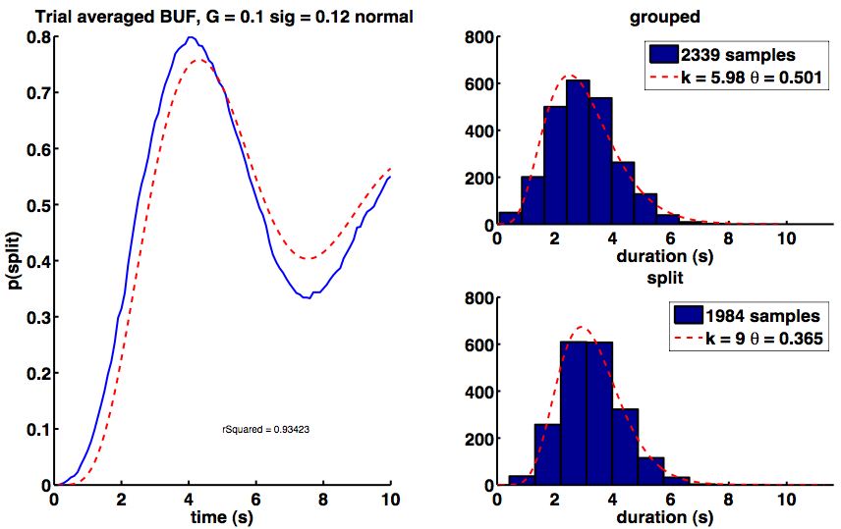
...even with violations of ARP assumptions
corrcoef(Durs(1:end-1), Durs(2:end)) = 0.239

Slide 18
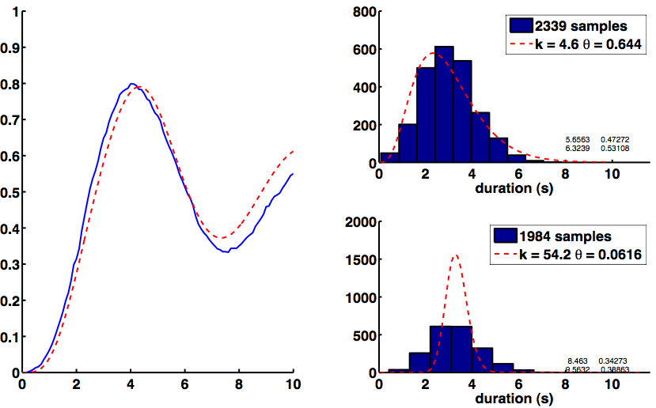
How well does BUF constrain densities?

Slide 19
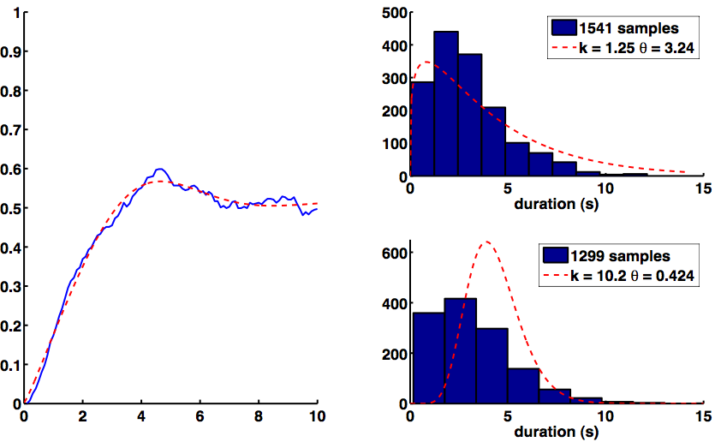

Slide 20
Conclusions
Competition model can give realistic-looking buildup curves, but only if noise is high and adaptation is low, supporting the attractor-model for these kinds of stimuli
The weaker the mechanism for alternation (noise + adaptation), the longer buildup takes to get to steady state
More ambiguous stimuli have slower buildup
MLE gamma -> ARP BUF works well, but LSE BUF > ARP gamma does not.

Slide 21
Future directions
add expression for first percept density, making 6 parameter model- use MLE to find first 2, and least squares fit to buildup function to find other 4 gamma density parameters
experiment with different duration pdf models- perhaps gamma is particularly unconstrained?
How should I set the value of the initial conditions? Buildup only occurs for ambiguous stimuli. Perhaps a2(0) is better than u1(0)
Can we explain the source of the noise? Is this noise fixed or can its strength be modulated internally?
What role does adaptation in peripheral neural channels play in causing the first percept to be more likely to be grouped and longer than later percept epochs?

